Slide 1
Cybersecurity for Hybrid Work
Recognizing Common Threats
Responding to Phishing Attempts
Multi-Factor Authentication & Strong Passwords
Secure Wi-Fi
Practices
(Government of Canada. (2025, June 4). Get Cyber Safe. Retrieved from https://www.getcybersafe.gc.ca/en)
Notes:
1. Recognizing Common Threats
Learn to identify common cybersecurity threats to better protect sensitive information.
2. How to respond appropriately to suspicious emails or phishing attempts.
Guidelines for recognizing and avoiding email-based scams and fraudulent messages.
3. Enabling two-factor authentication.
Importance and methods of enabling two-factor authentication for improved security.
Creating strong passwords
Techniques for creating strong, complex passwords to enhance account security.
4. Secure Wi-Fi
Training on using secure Wi-Fi networks to prevent unauthorized access and potential data breaches.

Slide 2
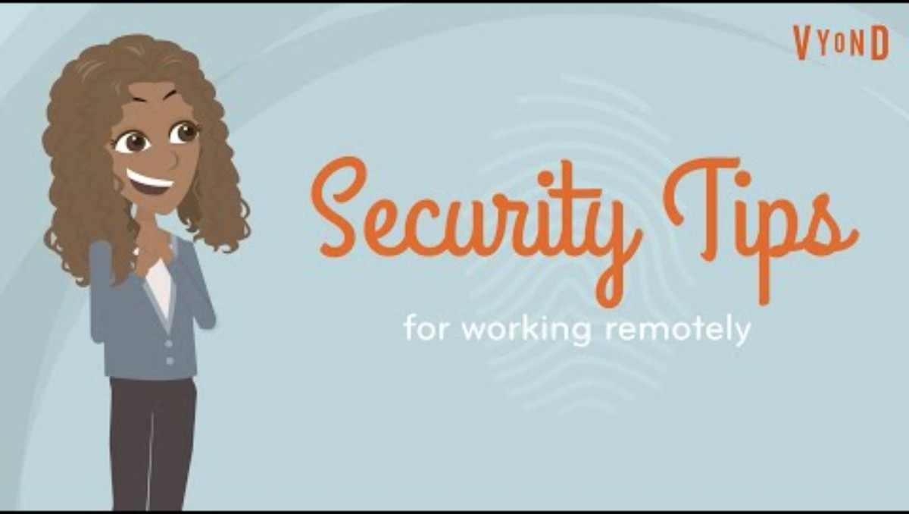
Common Threats
Share in chat:
How are cyber risks addressed by you or the company?
(Maranello Technology Management. (2020, April). Remote Work Security: Protecting Your Data and Privacy [Video]. YouTube. Retrieved from
https://youtu.be/n9yYprpKoKM)

Slide 3
Common Threats – Take-aways
1. Keep devices and printed info secure at home & in public spaces
2. Create secure passwords & use approved password management software
3. Use approved antivirus and anti-malware software
4. Keep your Wi-Fi connection secure (VPN)
5. Recognize phishing emails, SMS and websites
(Maranello Technology Management. (2020, April). Remote Work Security: Protecting Your Data and Privacy [Video]. YouTube. Retrieved from
https://youtu.be/n9yYprpKoKM)

Slide 4

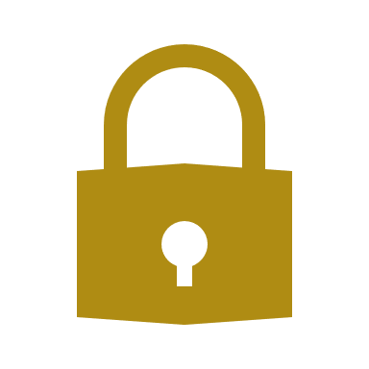
Phishing Response
Do NOT click the link
Close the pop-up window
Goto the official Office365 login page
Check for unusual activity
Act if you already clicked it:
change password & report to IT/security team
Extra Tips:
VPN on public Wi-Fi
Pop-up blocker
Multi-factor authentication (MFA)
(Microsoft. (n.d.). Protect yourself from phishing. Microsoft Support. Retrieved from
https://support.microsoft.com/en-us/windows/protect-yourself-from-phishing-0c7ea947-ba98-3bd9-7184-430e1f860a44)
Notes:
This could be a phishing attempt designed to steal your login credentials.
Don’t interact with it—especially not by entering any information.
`https://office.com` or `https://portal.office.com`. If your session really has expired, Office365 will prompt you to sign in again.
change your password & report to IT/security team.
Extra Tips:
Use a VPN when working in public places like cafés.
Make sure your browser has a pop-up blocker enabled.
Keep multi-factor authentication (MFA) enabled for added protection.

Slide 5
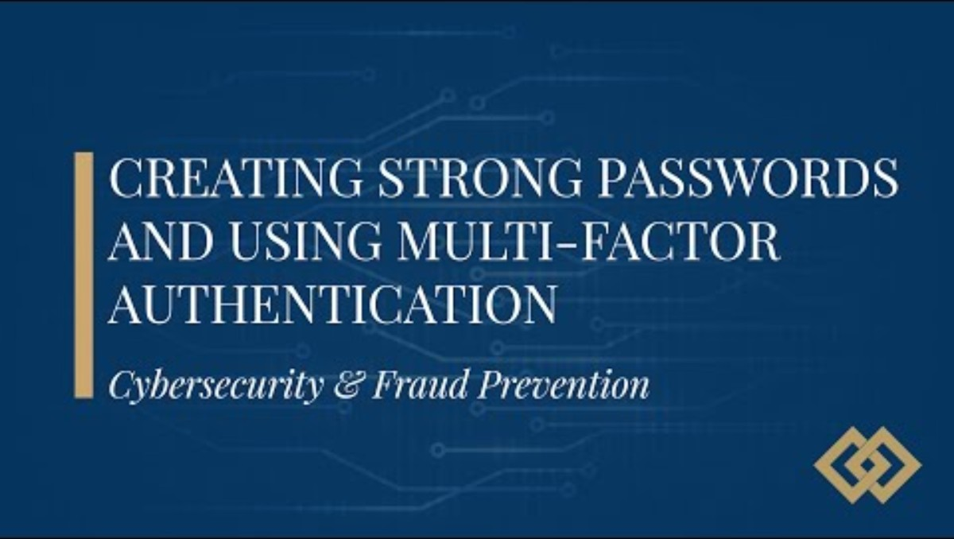
Strong Passwords & MFA
How do these points compare to your cyber security practices?
(Partners Bank of California. (2024, October). Creating Strong Passwords and Using Multi‑Factor Authentication (MFA) [Video]. YouTube. Retrieved from
https://youtu.be/uu_1oRMJ_8c)

Slide 6
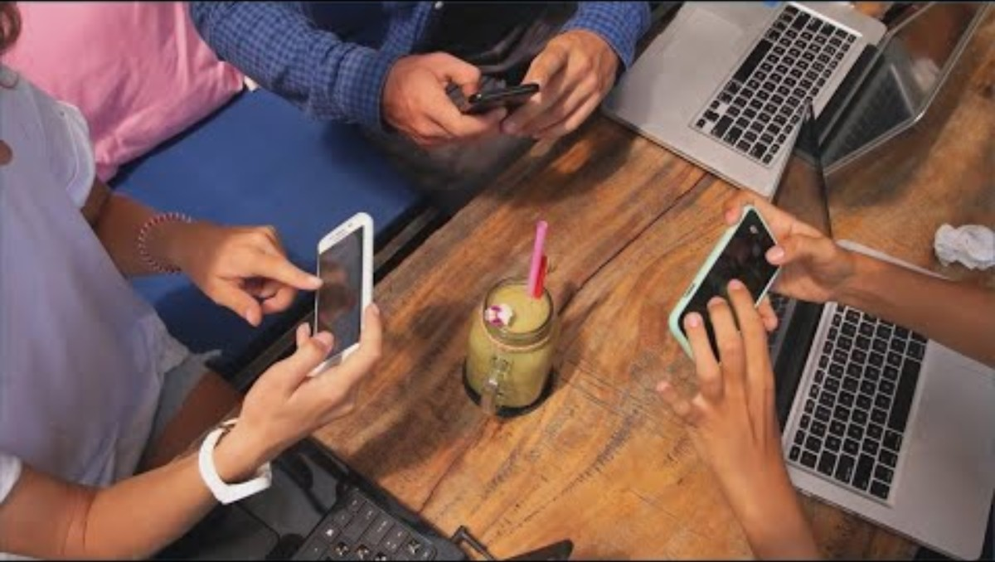
Wi-Fi Security
How do these points compare to your cyber security practices?
KHOU 11. (2024, October 9). Cybersecurity experts warn of public wifi dangers [Video]. YouTube. Retrieved from https://youtu.be/wWjXAyLEr6M)

Slide 7
Cyber Hygiene in Action
Strong Passwords
Complexity
Password manager
Change regularly
Multi-Factor Auth
Chose methods
Most sensitive accounts first
Periodically review
PublicWi-Fi
Fake access points
Secure sites – https
VPN
Data hotspot
(Partners Bank of California. (2024, October). Creating Strong Passwords and Using Multi‑Factor Authentication (MFA) [Video]. YouTube. Retrieved from
https://youtu.be/uu_1oRMJ_8c)
KHOU 11. (2024, October 9). Cybersecurity experts warn of public wifi dangers [Video]. YouTube. Retrieved from https://youtu.be/wWjXAyLEr6M)
Notes:
Strong Passwords
Min. 12 characters
Random characters
Unique combinations
MFA methods
1. Something you know - Passwords & pins
2. Something you have - A mobile devices and security tokens
3. Something you are - Biometrics like fingerprint, retinal scan or facial recognition

Slide 8

Quiz Time
Before disposing of documents with sensitive information…
  Throw them in the recycling bin
  Delete the file from your computer
  Shred the documents using a cross-cut shredder
  Save them for future reference
OpenAI. (2025). ChatGPT-4o [Large language model]. https://chat.openai.com/
Notes:
1. What should you do before disposing of documents with sensitive information?
A. Throw them in the recycling bin
B. Delete the file from your computer
C. Shred the documents using a cross-cut shredder ✅
D. Save them for future reference

Slide 9
Quiz Time
What is the BEST response to phishing email?
  Click the link to see where it goes
  Delete and report it to your IT or security team
  Reply asking if the email is legitimate
  Forward it to your colleagues to ask their opinion
OpenAI. (2025). ChatGPT-4o [Large language model]. https://chat.openai.com/
Notes:
2. What is the BEST action to take if you suspect an email is a phishing attempt?
A. Click the link to see where it goes
B. Reply asking if the email is legitimate
C. Delete it immediately and report it to your IT or security team ✅
D. Forward it to your colleagues to ask their opinion

Slide 10
Quiz Time
Which of the following is an example of MFA??
  Logging in with just your username and password
  Scanning a fingerprint to unlock your phone
  Using your browser’s auto-fill to sign in
  Entering a password, then confirming a code on a device
OpenAI. (2025). ChatGPT-4o [Large language model]. https://chat.openai.com/
Notes:
3. Which of the following is an example of MFA?
A. Logging in with just your username and password
B. Scanning a fingerprint to unlock your phone
C. Entering a password and then confirming a code sent to your phone ✅
D. Using your browser’s auto-fill to sign in
4. What is a recommended best practice for creating passwords?
A. Use your birthdate or pet’s name
B. Use the same password for all accounts
C. Use a mix of uppercase, lowercase, numbers, and symbols ✅
D. Keep passwords short to remember easily
5. Which of the following is a best practice when using public Wi-Fi?
A. Accessing your bank account
B. Logging into work email on a friend’s device
C. Using a Virtual Private Network (VPN) ✅
D. Renewing your device firewall

Slide 11
Quiz Time
What is a recommended practice for creating passwords?
  Use a mix of uppercase, lowercase, numbers, and symbols
  Use your birthdate or pet’s name
  Use the same password for all accounts
  Keep passwords short to remember easily
OpenAI. (2025). ChatGPT-4o [Large language model]. https://chat.openai.com/
Notes:
4. What is a recommended best practice for creating passwords?
A. Use your birthdate or pet’s name
B. Use the same password for all accounts
C. Use a mix of uppercase, lowercase, numbers, and symbols ✅
D. Keep passwords short to remember easily
5. Which of the following is a best practice when using public Wi-Fi?
A. Accessing your bank account
B. Logging into work email on a friend’s device
C. Using a Virtual Private Network (VPN) ✅
D. Renewing your device firewall

Slide 12
Quiz Time
Which is a recommended practice when using public Wi-Fi?
  Renewing your device firewall
  Logging into work email on a friend’s device
  Accessing your bank account
  Using a Virtual Private Network (VPN)
OpenAI. (2025). ChatGPT-4o [Large language model]. https://chat.openai.com/
Notes:
5. Which of the following is a best practice when using public Wi-Fi?
A. Accessing your bank account
B. Logging into work email on a friend’s device
C. Using a Virtual Private Network (VPN) ✅
D. Renewing your device firewall

Slide 13

Post-Workshop Resources
Get Cyber Safe. Government of Canada. www.getcybersafe.gc.ca
Cybersecurity for Hybrid Work – PDF of PPT deck
https://facilitationhub.ca/wp-content/uploads/2025/07/cybersecurity-for-hybrid-work-2.pdf

